Slide 1
CSP554 Big Data Technologies
NoSQL Key/Value + Wide Column Store
Apache HBase (Hadoop)

Slide 2
HBase
Apache Hadoop has gained popularity for storing, managing and processing high volume and high velocity data
However, the Hadoop filesystem (HDFS) cannot handle random writes and reads and cannot change a file without rewriting it
HBase is a NoSQL, column oriented database built on top of Hadoop to overcome the drawbacks of HDFS as it allows fast random writes and reads in an optimized way
Also, with exponentially growing data, relational databases cannot handle the variety of data to render better performance
HBase provides scalability and partitioning for efficient storage and retrieval

Slide 3
HBase
HBase provides real-time read or write access to data in HDFS
HBase can be referred to as a data store instead of a database…
As it misses out on some important features of traditional RDBMs…
Like typed columns, triggers, an advanced (SQL) query language and secondary indexes

Slide 4
HBase Features
Linear (horizontal) scalability
Capable of storing hundreds of terabytes of data
Strongly consistent reads/writes
HBase is not an "eventually consistent" data store
This makes it very suitable for tasks such as high-speed counter aggregation
Automatic sharding (splitting across a cluster)
HBase tables are distributed on the cluster via regions, and regions are automatically split and re-distributed as your data grows
Automatic failover
Hadoop/HDFS/S3 Integration
HBase supports HDFS out of the box as its distributed file system
It is possible to configure EMR to use S3 for HBase storage

Slide 5
HBase Features
Java Client API: HBase supports an easy to use Java API for programmatic access.
Thrift/REST API: HBase also supports Thrift and REST for non-Java front-ends.

Slide 6























HBase @ Salesforce
Variety
2200+
Nodes Across All Clusters
Simple Row Store Denormalization Messaging
Event Log Analytics Metrics Graphs Cache
120 TB
Typical Cluster Data Volume

Slide 7
HBase Data Model
Applications store data in tables
Tables are made of rows and columns
Columns are grouped into column families
All column family members have a common prefix…
Columns info:format and info:geo are both members of the info column family…
While contents:image belongs to the contents family
Table cells—the intersection of row and column coordinates—are versioned
By default, their version is a timestamp auto-assigned by HBase at the time of cell insertion
A cell’s content is an uninterpreted array of bytes

Slide 8
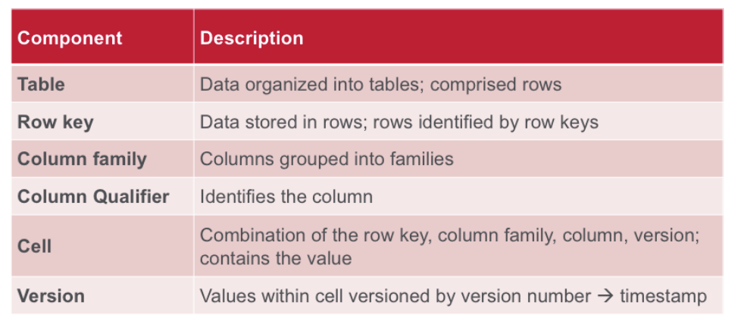
HBase Data Model: Components

Slide 9
HBase Logical Data Organization
Cells

Slide 10
HBase Data Model
A table’s column families must be specified up front as part of the table schema definition
But new column family members (new columns) can be added on demand
For example, a new column info:camera can be offered by a client as part of an update, and its value persisted
As long as the column family info already exists on the table
All column family members are stored together on the filesystem
So HBase can be considered largely, although not completely, schemaless

Slide 11
HBase Logical Data Organization
V1
V2
V1
V1
V2
V3

Slide 12
HBase Data Model
Table row keys are also byte arrays
So theoretically anything can serve as a row key, from strings to binary representations of long or even serialized data structures
Table rows are sorted by row key, aka the table’s primary key. The sort is byte-ordered
All table accesses are via the primary key, there are no secondary indexes

Slide 13
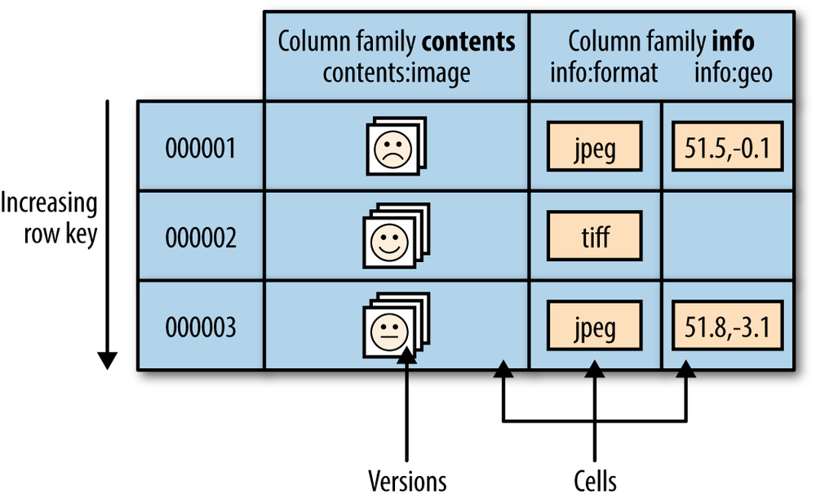
HBase Data Model

Slide 14
HBase Data Model
HBase tables are like those in an RDBMS except…
Cells are versioned
Rows are sorted
Columns can be added on the fly by the client as long as the column family they belong to preexists

Slide 15
ACID Properties
HBase is not ACID-compliant, but does guarantee certain specific properties…
All changes are atomic within a row
Any put will either wholly succeed or wholly fail
But API calls that change several rows will not be atomic across the multiple rows
All rows returned via any access API will consist of a complete (consistent) row that existed at some point in the table's history

Slide 16
When to Consider HBase
HBase isn’t suitable for every problem.
First, make sure you have enough data
If you have hundreds of millions or billions of rows, then HBase is a good candidate
If you only have a few thousand/million rows, then using a traditional RDBMS might be a better choice…
Due to the fact that all of your data might wind up on a single node (or two) and the rest of the cluster may be sitting idle
Make sure you can live without all the extra features that an RDBMS provides
Such as typed columns, secondary indexes, transactions, advanced query languages, etc.

Slide 17
When to Consider HBase
An application built against an RDBMS cannot be "ported" to HBase by simply changing a JDBC driver, for example
Consider moving from an RDBMS to using HBase as a complete redesign as opposed to a port

Slide 18
HDFS vs. HBase
HDFS | HBase
Distributed file system | Built on top of HDFS
No fast data lookups | Fast data lookups via indexed files
Latency : high | Latency : low
Only sequential access | Random access via hash tables

Slide 19
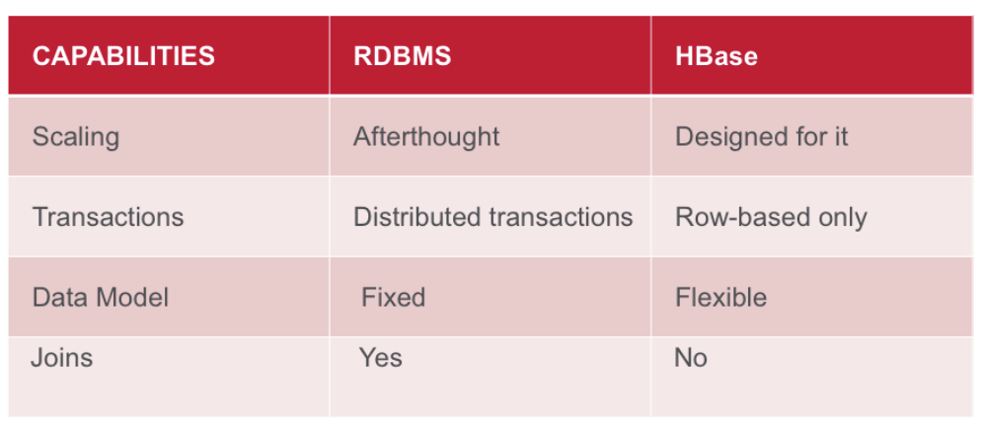
HBase vs. RDBMS Summary

Slide 20
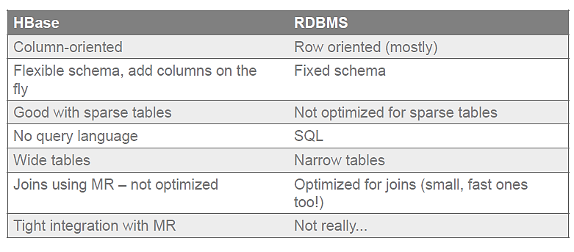
HBase vs. RDBMS Details

Slide 21
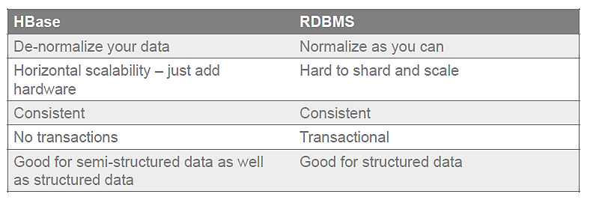
HBase vs. RDBMS Details

Slide 22
Hbase Uses
Capture Event Data, Time Series Data
Sensor, System metrics, Events, Log files
User Activity
High Volume, Velocity Writes
Information Exchange, Messaging
Email, Chat, Inbox
High Volume, Velocity Read\Write
Content Serving, Web Application Backend
Online Catalog
Search Index
Pre-Computed View
High Volume, Velocity Reads

Slide 23

HBase Uses
Large Data Volume running into at least hundreds of GBs or more (aka Big Data)
Data access patterns are well known at design time and are not expected to change i.e. no secondary indexes / joins need to be added at a later stage
RDBMS-like multi-row transactions are not required
Large amount of different records of data being accessed or updated
Multiple versions of data

Slide 24
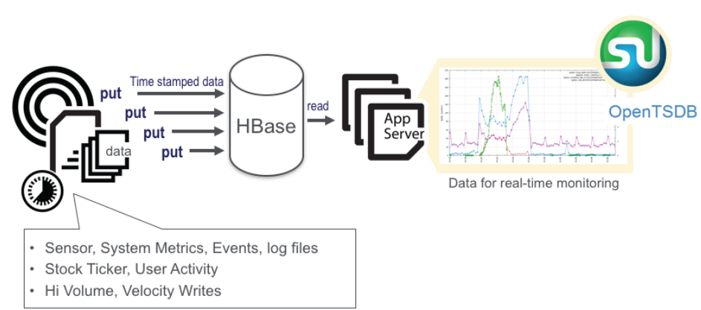
Time Series Data

Slide 25
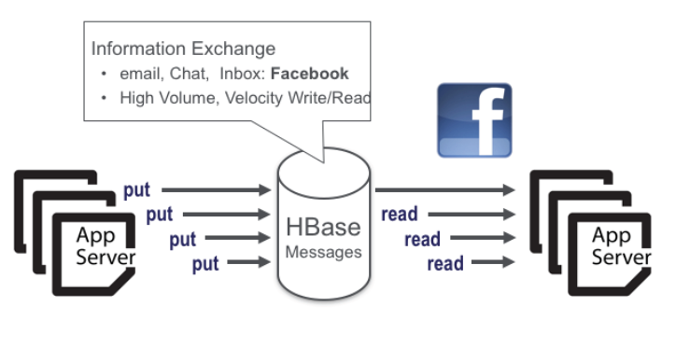
Information Exchange

Slide 26
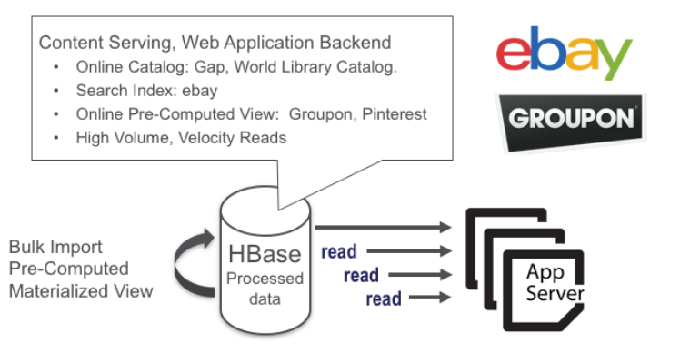
Content Serving

Slide 27
What HBase is NOT
Not an SQL database
Not relational
No joins
No powerful query language
No sophisticated query engine
No transactions out-of-the box
No secondary indices out-of-the box
Not a drop-in replacement for RDBMS

Slide 28
HBase Shell
$ hbase shell
hbase>
After you have started HBase, you can access the database interactively by using the HBase Shell

Slide 29
Using the HBase Shell
Names identifying tables and columns need to be quoted
There is no need to quote constants
Command parameters are separated using commas
To run a command after typing it in the shell hit enter key
Double quoting is required when you need to use binary keys or values in the shell
To separate keys and values you use the => character
To specify a key you use predefined constants like NAME, VERSIONS and COMPRESSIONS

Slide 30
Using the HBase Shell
To get help and see all commands, use the help command
To get help on a specific command, use help "command”
hbase> help "create"

Slide 31
Create a Table
In its simplest form the create command is used to create a table by specifying the table name and column family
To reduce disk space used for storing data it is advisable to use short column family names.
This is because storage of each value happens in a fully qualified manner
Frequent change of column names and use of many column families is not good practice
A compromise design is to have a few column families then you can have many columns in each family.
The format of naming columns is to specify the column family then the column name (family:qualifier).

Slide 32
Create a Table
A basic command that creates a table with two column families is shown below
create ‘courses’, ‘hadoop’, ‘programming’
To add columns in each column family the command is enhanced as shown below
create ‘courses’, ‘hadoop:spark’, ‘programming:java’

Slide 33
Create a Table
HBase allows you to have multiple versions of a row
This arises because data changes are not applied in place, instead a change results in a new version
To control how this happens you specify the number of versions or time to live (TTL)
When any of these settings are exceeded rows are removed when data compaction is done
create t1, ’f1’, {NAME => ’f2’, VERSIONS => 3}

Slide 34
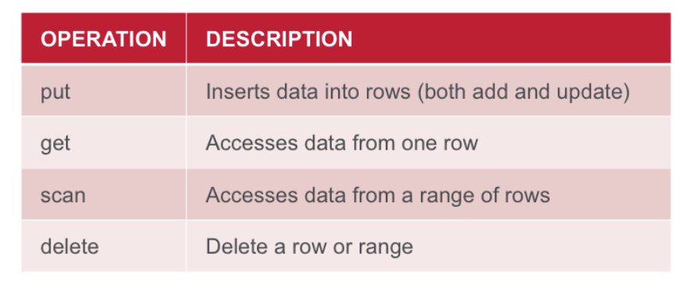
Basic Data Access Operations

Slide 35
Put Data into a Table
If you’re using HBase, then you likely have data sets that are TBs in size
As a result, you’ll never actually insert data manually
However, knowing how to insert data manually could prove useful at times
Put a cell ‘value’ at specified table/row/column:
put <'tablename'>,<'rowname'>,<'columnvalue'>,<'value’>
Example
put 'cars', 'row1', 'vi:make', 'bmw'

Slide 36
Get Data From a Table
The get command allows you to get one row of data at a time
You can optionally limit the number of columns returned
We’ll start by getting all columns in row1
get 'cars', 'row1’
To get one specific column include the COLUMN option.
get 'cars', 'row1', {COLUMN => 'vi:model'}
You can also get two or more columns by passing an array of columns.
get 'cars', 'row1', {COLUMN => ['vi:model', 'vi:year']}

Slide 37
Scan Data From a Table
Selectively query the contents of a table
scan 'tablename', {Optional parameters}
Pass table name and optionally a dictionary of scanner specifications
Scanner specifications may include one or more of:
TIMERANGE, FILTER, LIMIT, STARTROW, STOPROW, TIMESTAMP, MAXLENGTH, COLUMNS, CACHE
If no columns are specified, all columns will be scanned
To scan all members of a column family, leave the qualifier empty as in ‘col_family:’

Slide 38
Scan Data From a Table
We’ll start with a basic scan that returns all columns in the cars table.
scan 'cars’
The next scan we’ll run will limit our results to the make column qualifier.
scan 'cars', {COLUMNS => ['vi:make’]}
If you have a particularly large result set, you can limit the number of rows returned with the LIMIT option
scan 'cars', {COLUMNS => ['vi:make'], LIMIT => 4}
Specify a startrow, limit the result to 10 rows, and only return selected columns
scan ‘cars', {COLUMNS => ['vi:make '], LIMIT => 10, STARTROW => 'xyz'}

Slide 39
HBase Scalability
Tables are automatically partitioned horizontally by HBase into regions
Each region comprises a subset of a table’s rows
A region is denoted by the table it belongs to, its first row (inclusive), and its last row (exclusive)
Initially, a table comprises a single region, but as the region grows it eventually crosses a configurable size threshold…
At which point it splits at a row boundary into two new regions of approximately equal size
Until this first split happens, all loading will be against the single server hosting the original region

Slide 40
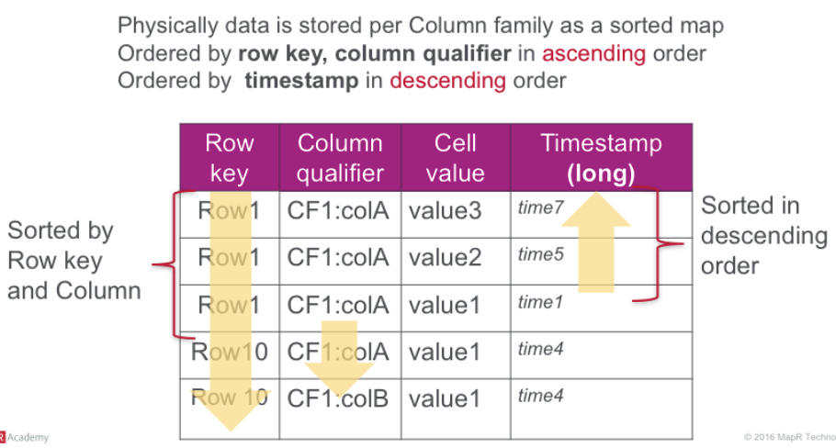
HFile Physical View

Slide 41
HBase Scalability
So this is why HBase is described as a column store
Each region holds an ordered subset of a table’s rows
Within a region each column family is stored separately (in an HFile)
So queries on just one column family of a table result in faster lookups and also the need to scan less data
Queries that span regions can be parallelized to the extent that regions are stored across multiple nodes (region servers)
Tables can grow to terabytes and more while no region will grow to beyond a configured maximum size before automatic resharding occurs

Slide 42
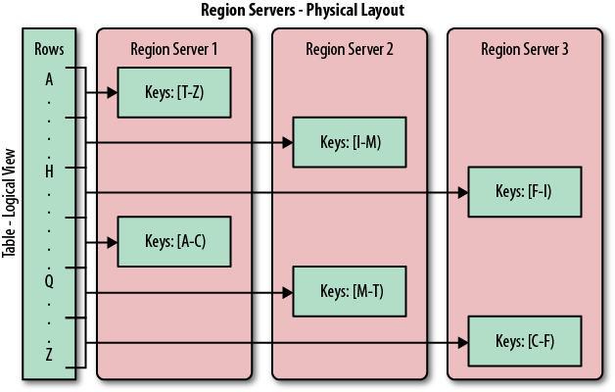
HBase Scalability

Slide 43
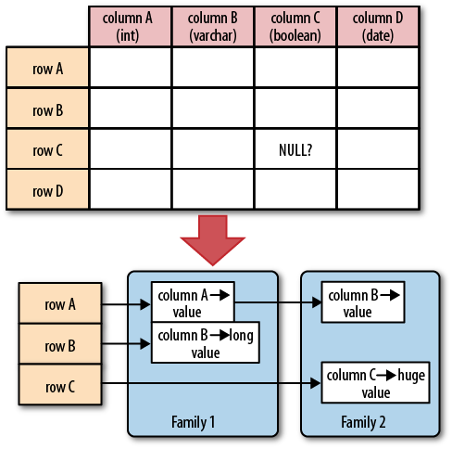
Sparse Table Storage
For a database with a fixed schema, you have to store NULLs where there is no value
But for HBase you simply omit the whole column…
In other words, NULLs do not occupy any storage space

Slide 44
Apache Phoenix
Apache Phoenix takes your SQL query, compiles it into a series of HBase scans to produce JDBC result sets
Use of the HBase API, along with coprocessors and custom filters, results in performance on the order of milliseconds for small queries, or seconds for tens of millions of rows.

Slide 45
Apache Phoenix
A SQL Extension for Hbase
Provides a SQL interface for managing data in Hbase.
Large subset of SQL:1999 mandatory feature set.
Create tables, insert and update data and perform low-latency point lookups through JDBC.
Phoenix JDBC driver easily embeddable in any app that supports JDBC.
Phoenix Makes HBase Better
Oriented toward online / semi-transactional apps
Performance on the order of milliseconds for small queries, or seconds for tens of millions of rows.

Slide 46

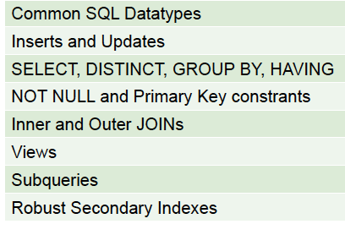
Apache Phoenix: Current Capabilities
Features

Slide 47
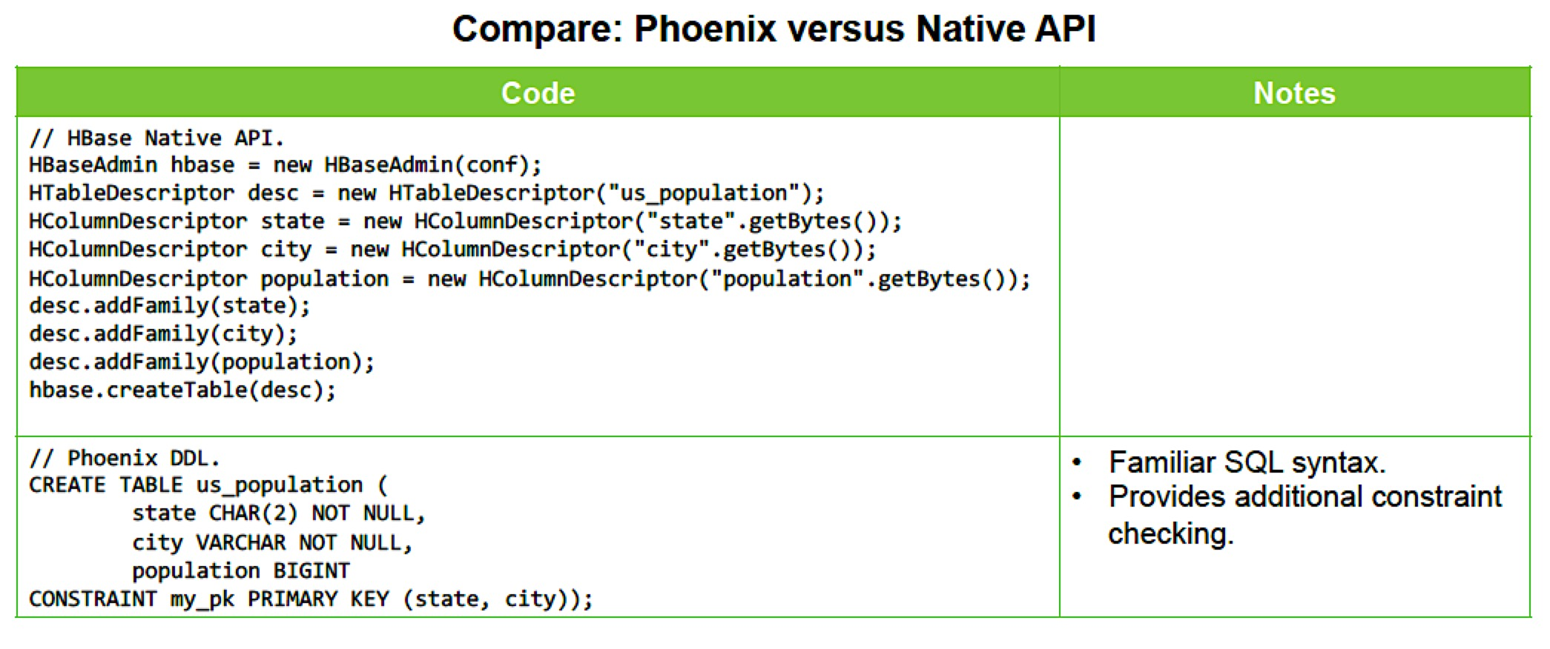
Phoenix Provides Familiar SQL Constructs

Slide 48
Phoenix Performance
Phoenix Performance Characterization:
Suitable for 10s of thousands of point-lookups per second
Suitable for thousands of aggregations / filtered searches per second
Supports extremely high concurrency.
Performance characteristics:
Index point lookups in milliseconds
Aggregation and Top-N queries in a few seconds over large datasets.

Slide 49
HBase Architecture: Table
A Table is a collection of rows organized in ascending lexicographic order by row key.

Slide 50
HBase Architecture: Region
A region is a continuous, ordered subset of a table’s rows

Slide 51
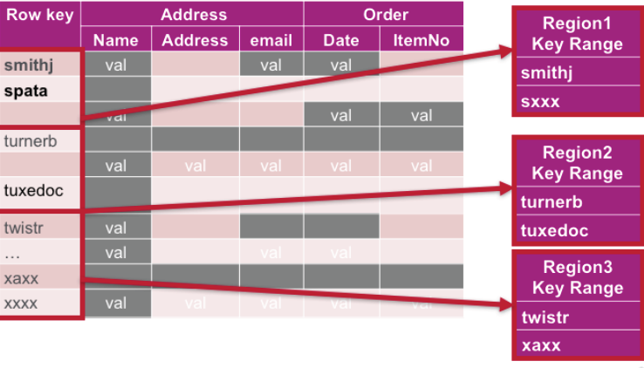
HBase Architecture: Region
The rows of a table region are stored together on the same server or virtual machine
HBase Cluster
Server A
Server B
Server C

Slide 52
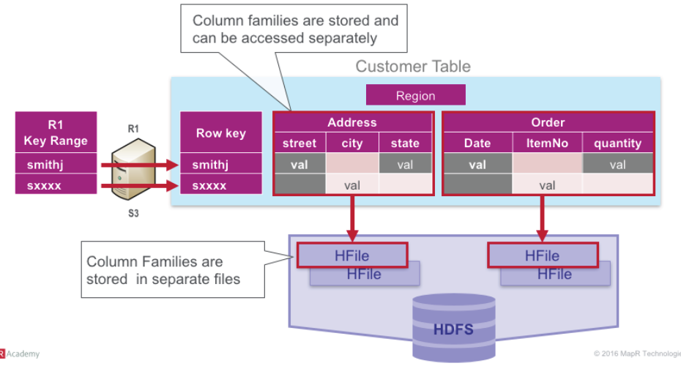
HBase Architecture: Region
The the row data associated with a region are divided into column facilities, with the data for each column family stored into a separate file (HFile)

Slide 53
HFile Format Information
All data is stored in a custom (open-source) format, called HFile
Data is stored in blocks (64KB default)
Trade-off between lookups and I/O throughput
Compression, encoding applied _after_ limit check
Index, filter and meta data is stored in separate blocks
Fixed trailer allows traversal of file structure
Newer versions introduce multilayered index and filter structures
Only load master index and load partial index blocks on demand
Reading data requires deserialization of block into cells
Kind of Amdahl’s Law applies

Slide 54
HBase Architecture: Region Servers
Regions are assigned to Region Servers across a cluster
Each Region Servers holds about the same number of regions

Slide 55
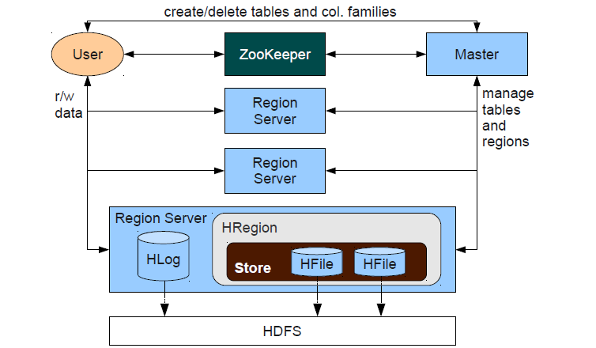
HBase Logical Architecture
Hadoop/HDFS
Data Node
Hadoop/HDFS
Data Node
Hadoop/HDFS
Data Node

Slide 56
HBase Architecture: General
HBase made up of an HBase supervisory (master) node orchestrating a cluster of one or more regionserver nodes
The HBase master is responsible for assigning regions to registered regionservers, and for recovering regionserver failures
The regionservers carry zero or more regions and handle client read/write requests
They also manage region splits, informing the HBase master about the new regions

Slide 57
HBase Architecture: General
An HBase RegionServer is collocated with an HDFS DataNode
HBase clients communicate directly with Region Servers for sending and receiving data.
HMaster manages Region assignment and handles DDL operations.
Online configuration state is maintained in ZooKeeper
HMaster and ZooKeeper are NOT involved in data path

Slide 58
HBase Architecture: General
Region
a subset of table’s rows, like a range partition
Automatically sharded
RegionServer
Servers data for reads and writes for a group of regions
Master
Responsible for coordinating the RegionServers
Assign regions, detects failures of RegionServers
Control some admin functions
ZooKeeper
Locate data among RegionServers

Slide 59
HBase Scalability
As the table grows, the number of its regions grows
Regions are the units that get distributed over an HBase cluster
In this way, a table that is too big for any one server can be carried by a cluster of servers, with each node hosting a subset of the table’s total regions
This is also the means by which the loading on a table gets distributed
The online set of sorted regions comprises the table’s total content.

Slide 60
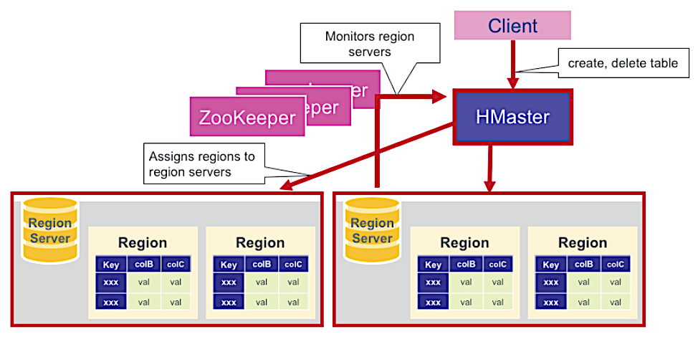
HBase HMaster

Slide 61
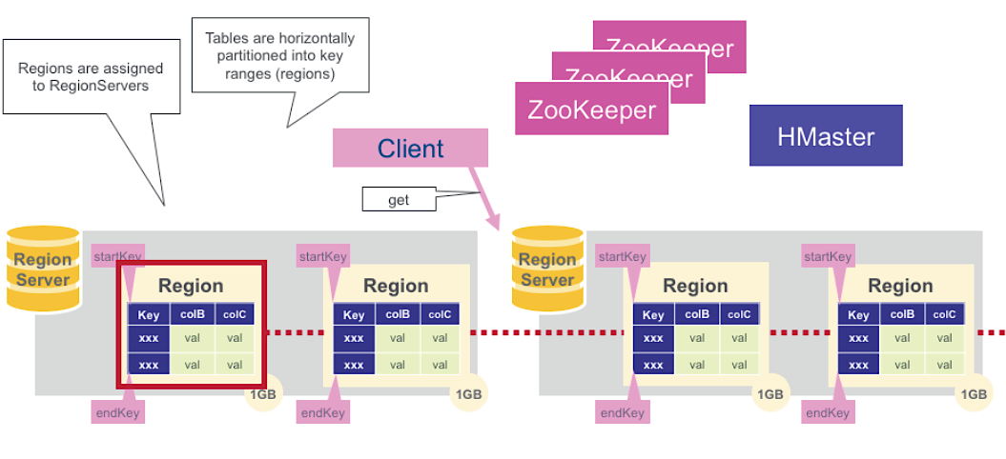
Regions

Slide 62
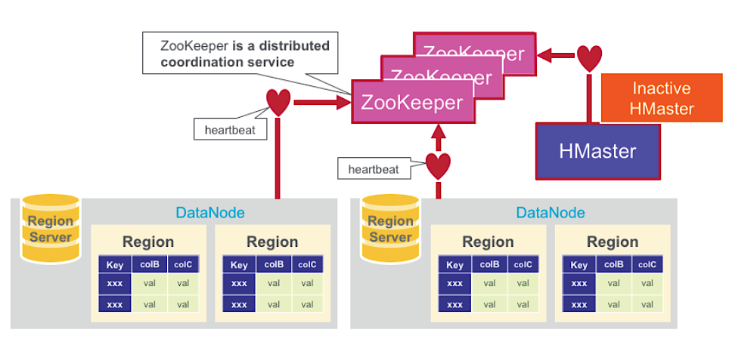
Zookeeper (Coordinator)

Slide 63
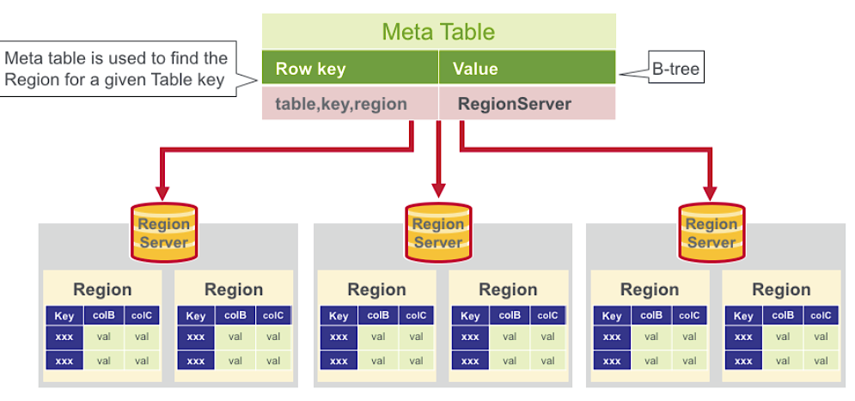
HBase Meta Table

Slide 64
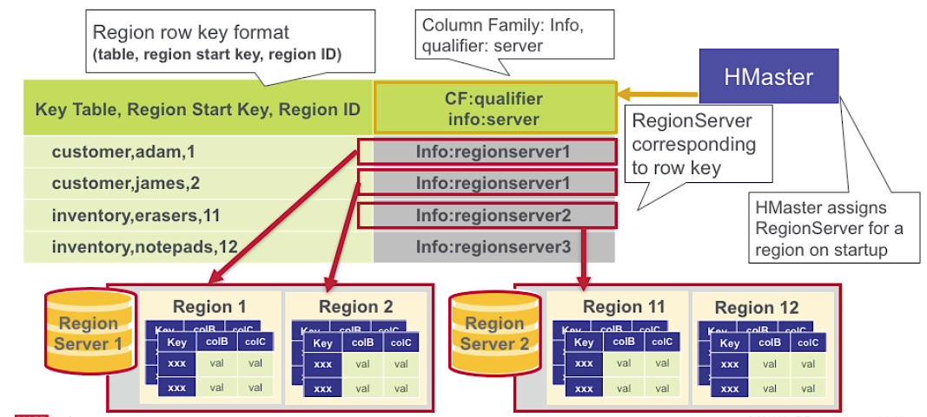
HBase Meta Table

Slide 65



























HBase Internals
Write Operation
Zookeeper
Region Server
HDFS
4. Write
WAL
1. Get .META. location
Region
HFile
HFile
HFile
Client
3. Put
Store
5. Write
Memstore
Memstore
Memstore
Flush
HFile
HFile
HFile
2. Get Region
location
…..
Region Server
HFile
HFile
HFile
.META.
Region
Region
Region
……....
…..

Slide 66

HBase Internals
Compaction
HFile
HFile
HFile
HFile
Main purpose of compaction is to optimize read
performance by reducing the number of disk seeks
HFile
HFile
HFile
HFile
HFile
…
Minor Compaction
Trigger: Automatic based on configurations
Mechanism
Reads a configurable number of smaller HFiles and writes into a single large HFile
Major Compaction
Trigger: Scheduled or Manual
Mechanism
Reads all HFiles of a region and writes to a single large HFile
Physical deletion of records
Tries to achieve high data locality

Slide 67


















HBase Internals
Read Operation
Zookeeper
Region Server
HDFS
Region
WAL
1. Get .META. location
4. Read
Block Cache
3. Get
5. Read
HFile
HFile
HFile
Client
6. Read
2. Get Region
location
Memstore
Mems…to..re
Memstore
HFile
HFile
HFile
Region Server
HFile
HFile
HFile
.META.
Region
Region
Region
Reg.…io.n
…..

Slide 68
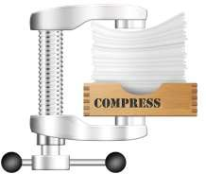
Compression
Compression is one of the storage optimization technique Commonly used compression algorithms in HBase
Snappy
Gzip
LZO
LZ4
Compression Ratio
Gzip compression ratio is better than Snappy and LZO
Resource Consumption
Snappy consumes lesser resources for compression and decompression than Gzip

Slide 69


Optimization Benefit
Reduced Storage Costs
Improved Throughput
Compression
Productivity Improvement
 | Before Optimization | After Optimization | %Improvement
Storage | 3300 GB | 963 GB | ~71%
Throughput | 260K Records/Min | 380K Records/Min | ~42%

Slide 70


When HBase?
HBase is for you
HBase is NOT for you
Random read/write access to high volumes of data in real time
No dependency on RDBMS features
Variable schema with flexibility to add columns
Single/Range of key based lookups for de-normalized data
Multiple versions of Big Data
Replacement for RDBMS Low data volume
Scanning and aggregation on large volumes of data
Replacement for batch processing
engines like MapReduce/Spark

